Slide 1
Part III
Notes:
Facilitator:
Part III of the module uses an outside resource that reflects the philosophy and value being studied. It is a deep dive into our philosophies and values; where they originated, why its important today, and what it looks like in action. Part III is intended to go deeper into the background and history of each philosophy. For the students are at the center of every decision philosophy we are using the book You Haven’t Taught Until They’ve Learned by Steve Nater and Ronald Gillmore. A summary is available in the resource folder.

Slide 2
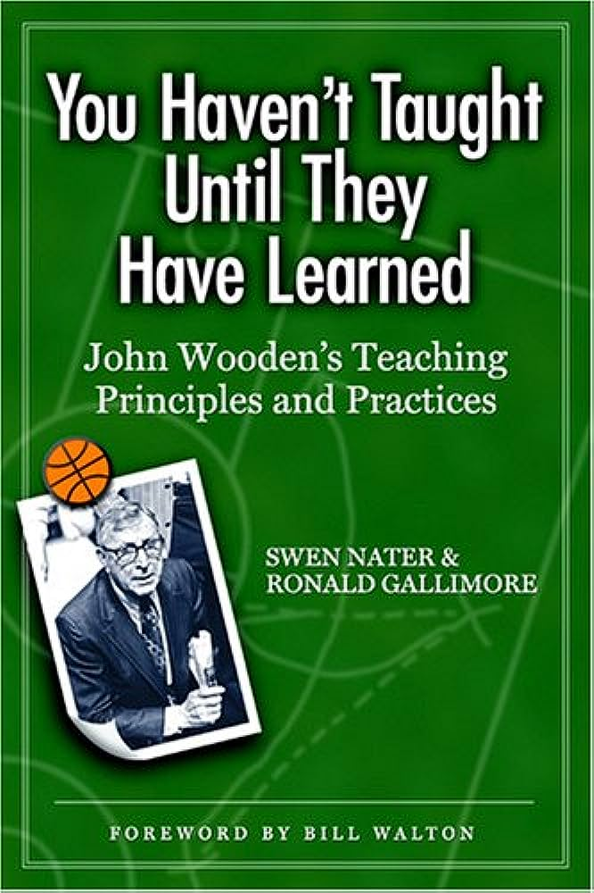
Quotes from You Haven’t Taught Until They Have Learned
“Industriousness (hard work) and enthusiasm (a genuine love for what you are doing) are the cornerstones for success.”
“Teacher respect, motivation, self-improvement, deep subject knowledge, preparation, and transferring information are qualities all teachers should possess at any level and in any environment.”
“Our relationship was forged slowly over time, and strengthened by the combination of the intense fire of his high expectations and my determination to learn. It matured when it became a “learning relationship” and my respect for him caught up with his respect for me.”
“Coach Wooden preached against comparisons and external rewards, and for focusing on becoming your best.”
Nater, You Haven’t Taught Until They Have Learned
Notes:
Script: Tiers I, II, III
Facilitator:
In their book, You Haven't Taught Until They Have Learned: John Wooden's Teaching Principles and Practices Nater and Gillimore, identify 11 qualities of favorite teachers. Wooden practiced those principles every day. He believed that his success came from the steady application of a teaching philosophy and practice based on the idea that “you haven’t taught until they have learned”. Another way of saying “A fair break for every kid.”
Please form a triad to discuss each of these attributes. Describe what the attribute looks like in action in your department/school.
Challenging expectations appropriate to each individual
Getting to know each individual
Caring for each as a person
Tailoring instruction and support to individual differences
Treating everyone with respect and fairness
As groups finish their discussion ask for 1-2 volunteers to share their examples for each attribute. Remain in triads to discuss one or more of the prompts (facilitator’s choice).
Discussion Points
101 – Think about which of the bolded attributes you believe is most important to the “A fair break for every kid” value and discuss why. Be ready to share with others.
201 – In Clovis we believe everyone is both a teacher and a learner. Thinking about your site/department identify an individual who demonstrates one or more of these attributes.
301 As a teacher/leader in this district which of the bolded statements would you like to improve within yourself. Why? What is your improvement plan. Discuss in small group.
As conversations end, ask each group to share one key learning.
“Coach Wooden’s approach succeeded: Setting challenging expectations appropriate to each individual; getting to know each individual well and caring for each as a person; tailoring his instructions and support to individual differences; and treating everyone with respect and fairness. It succeeded for him in the classroom, on the court, and in life.”

Slide 3
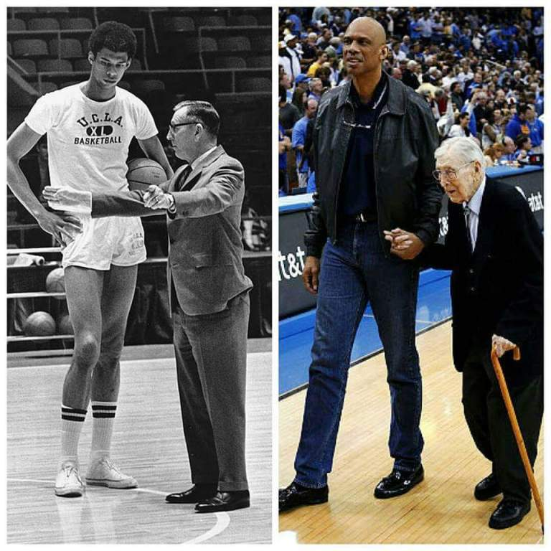
“A fair break for every kid” Doc
“Coach Wooden’s approach succeeded: Setting challenging expectations appropriate to each individual; getting to know each individual well and caring for each as a person; tailoring his instructions and support to individual differences; and treating everyone with respect and fairness. It succeeded for him in the classroom, on the court, and in life.”
Nater & Gilmore, You Haven’t Taught Until They Have Learned
This Photo by Unknown Author is licensed under CC BY
Notes:
Script: Tiers I, II, III
Facilitator:
This is a classic picture of Coach Wooden and Kareem Abdul-Jabar. They formed a bond while he played at U.C.L.A. under Coach Wooden. Let’s read Coach Wooden’s philosophy about how you treat people. I suspect this philosophy is one of the reasons Coach Wooden was able to maintain strong relationships with his players both on and off the court.
Please form a triad to discuss each of these attributes. Describe what the attribute looks like in action in your department/school.
Challenging expectations appropriate to each individual
Getting to know each individual
Caring for each as a person
Tailoring instruction and support to individual differences
Treating everyone with respect and fairness
As groups finish their discussion ask for 1-2 volunteers to share their examples for each attribute. Remain in triads to discuss one or more of the prompts (facilitator’s choice).
Discussion Points
101 – Think about which of the bolded attributes you believe is most important to the “A fair break for every kid” value and discuss why. Be ready to share with others.
201 – In Clovis we believe everyone is both a teacher and a learner. Thinking about your site/department identify an individual who demonstrates one or more of these attributes.
301 As a teacher/leader in this district which of the bolded statements would you like to improve within yourself. Why? What is your improvement plan. Discuss in small group.
As conversations end, ask each group to share one key learning.
“Coach Wooden’s approach succeeded: Setting challenging expectations appropriate to each individual; getting to know each individual well and caring for each as a person; tailoring his instructions and support to individual differences; and treating everyone with respect and fairness. It succeeded for him in the classroom, on the court, and in life.”

Slide 4
Teaching is much more than a job…
“For those teachers I have mentioned, and also for me, teaching is much more than a job. It is a responsibility to those under my supervision—a responsibility to teach them. And how can I tell if I’ve taught them, if I’ve been successful? Right. Only if they’ve learned. Therefore, I have learned to focus on studying people, especially young people. I study the way they react, the way they are motivated, the way they are frustrated, and the way they work. This will help me discover the way they learn and when I discover that, I’m half way there. The methods I learned, both for the classroom and for the court, were created from and for my students.”
John Wooden in You Haven’t Taught Until They Have Learned
Notes:
Script: Tiers I, II, III
Facilitator:
In Clovis Unified we believe everyone is a teacher. It does not matter what your position is in the district. You are a teacher for those you supervise and those who follow you. Let’s read the quote on the screen. Facilitator may red, popcorn read, or ask for volunteers to read each sentence.
Please find a partner to discuss Wooden’s belief on teaching. Remember everyone is a teacher no matter where you work. Discuss the following:
Do you agree with the statement “teaching is much more than a job”? Explain why or why not.
Do you believe you have a responsibility to “teach” those you supervise? Explain why or why not.
Are you responsible to teach those you supervise the foundational philosophies and values of CUSD? Explain why or why not.
As pairs finish call on volunteers to share their thoughts.
Now, let’s move to a larger group of 3-4 (facilitator’s choice) and discuss the following:
As a leader in this district, it is your responsibility to teach the philosophies of CUSD. Explain how do you go about making sure your employees learn our foundational philosophies and values? Even more importantly how do know they put them into practice?
As groups finish ask each group to share 1-2 key learnings from their discussions.
“Coach Wooden’s approach succeeded: Setting challenging expectations appropriate to each individual; getting to know each individual well and caring for each as a person; tailoring his instructions and support to individual differences; and treating everyone with respect and fairness. It succeeded for him in the classroom, on the court, and in life.”

Slide 5
On a piece of paper draw a Venn Diagram. Label one circle Clovis and one circle Wooden The middle is for similarities between the two plans to meet the needs of all students.
Notes:
Script: Tiers I, II, III
Facilitator:
Before we move on to our next activity please take out a piece of paper and draw a Venn Diagram. If you don’t know what a Venn diagram looks like there is one on the screen. Label one of the circles Clovis and the other circle Wooden. The middle circle is the similarities you see in teaching by Clovis teachers and Coach Wooden. Once participants have completed drawing the Venn Diagram move to the next slide.

Slide 6
We Do Not Give Up
“I could track the practice routines of every single player for every single practice session he participated in while I was coaching him…It was very important that I learn about each player and then study that player so I know if he needed a little more time on this or that. I needed to know which drill had greater application to this player or that player, because individuals vary. So I would devise drills for both individuals and the group and studied and analyzed them. Some drills would be good for all and some drills would be good for just certain players.”
John Wooden in You Haven’t Taught Until They Have Learned
Notes:
Script: Tiers I, II, III
Facilitator:
Let’s spend some time examining the similarities and differences between Coach Wooden and Clovis teachers for meeting the learning needs of all students.
To better understand the expectation of Clovis teachers let’s read pages 27-32 Teachers Role from the Historical Overview of CUSD (included in resource folder). It is a pretty long article so lets form small groups to jigsaw it. While you are reading I want you to think about your role in the district and how it supports teachers, which in turn supports our students.
Ask participants to form small groups (size is determined by facilitator). As you jigsaw the article record the strategies teachers use to meet the needs of all students. Allow time for participants to jigsaw the article. Now let’s look at the practices that are in bold on the screen. Let’s record the strategies used by Coach Wooden to meet the needs of his students.
Discussion Points
Remain in your groups to respond to one or more of the following prompts:
101 – As a group highlight the similarities between the practices of Clovis teachers and Coach Wooden. Record them on the Venn Diagram
201 - Everyone is both a teacher and a learner. Thinking about your site and/or department discuss what you do supports teachers and student learning. Explain your thinking.
301 As a teacher/leader in this district which of the bolded statements would you like to improve within yourself. Why? What is your improvement plan. Discuss in a small group.
As groups finish ask each group to share 1-2 of their answers.
“Coach Wooden’s approach succeeded: Setting challenging expectations appropriate to each individual; getting to know each individual well and caring for each as a person; tailoring his instructions and support to individual differences; and treating everyone with respect and fairness. It succeeded for him in the classroom, on the court, and in life.”

